Slide 1
Data Analysis And Visualization Of Green Taxi Records
Building Serverless ML Platform
SRI HARSHA KORUKONDA BHATTAR (1953040)
AASHISH JOSHI (1886750)
ANKITH KANDALA (1894221)

Slide 2
Contents:
Introduction
Serverless Architecture
Methodology
Challenges
Future work

Slide 3
INTRODUCTION
Building a serverless Machine Learning platform that analyses, visualizes Green-taxi user data and predicts future customer base.

Slide 4
SERVERLESS ARCHITECTURE
Serverless is the native architecture of the cloud that enables you to shift more of your operational responsibilities to AWS.
Serverless enables us to build modern applications with increased agility and lower total cost of ownership.

Slide 5




METHODOLOGY
AWS S3
SageMaker Instance
AWS Tools used:
Amazon S3
Lambda function
Sagemaker Instance
Sagemaker Endpoint
AWS API
SageMaker Endpoint
Lambda Function
API Gateway

Slide 6
6 years Green taxi Trip records for the state of New York have been collected.
Monthly Raw data files are stored in S3.
We have implemented Python to organize and analyze the Raw data.
ML Algorithms – Multiple Linear Regression.

Slide 7
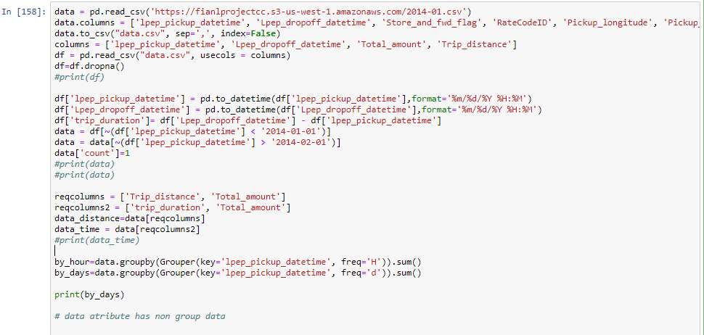
Here you have a list of items
And some text
But remember not to overload your slides with content
Your audience will listen to you or read the content, but won’t do both.

Slide 8
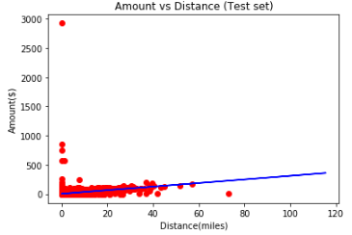
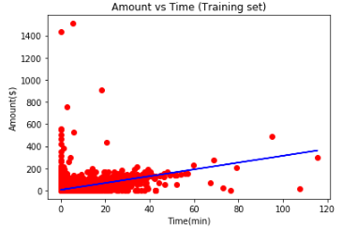
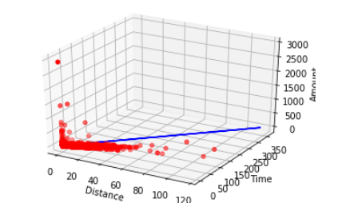

Slide 9
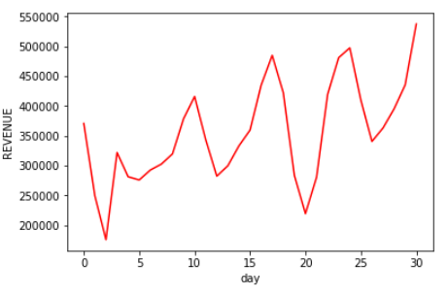
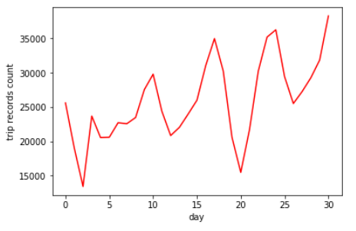
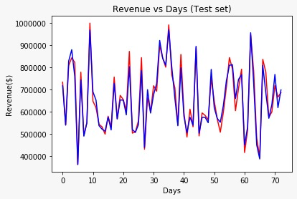

Slide 10
Prediction Accuracy for trip pricing – 92.4% Prediction Accuracy for revenue and customer base – 86.8%

Slide 11
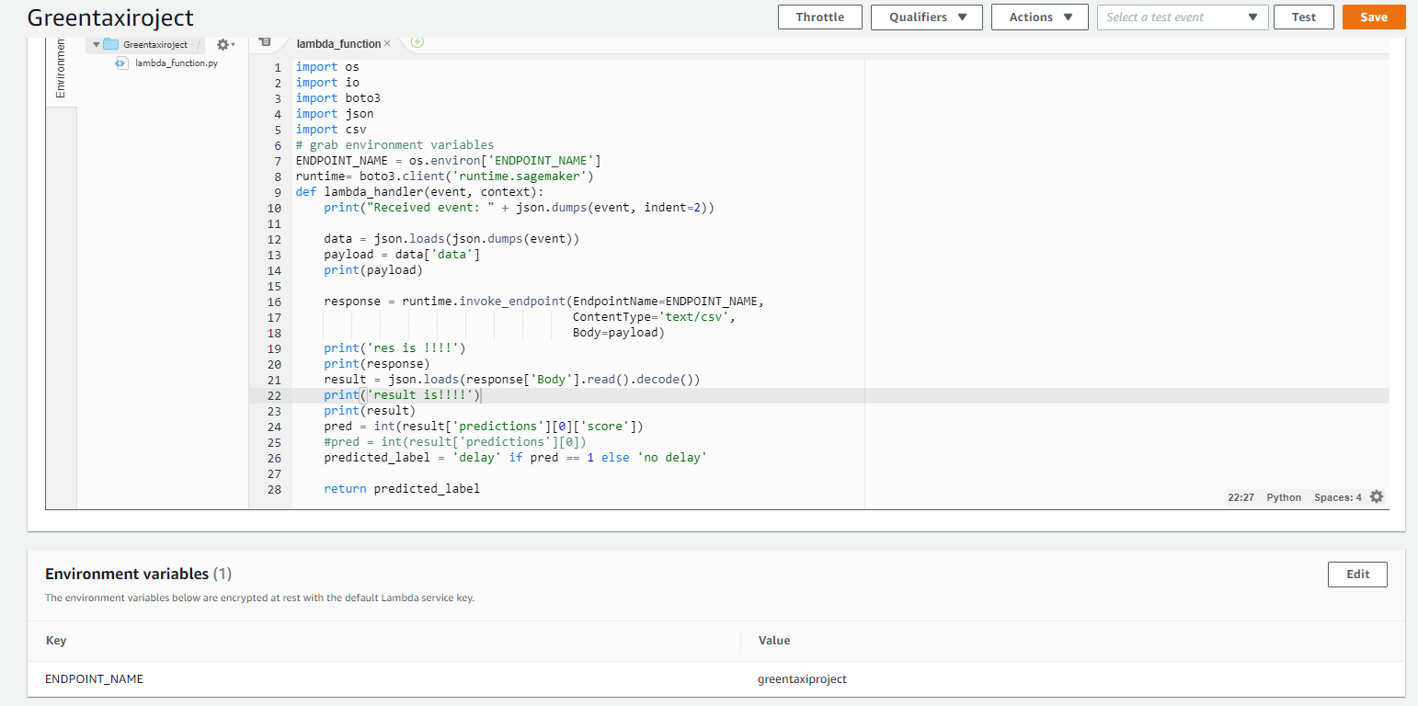

Slide 12
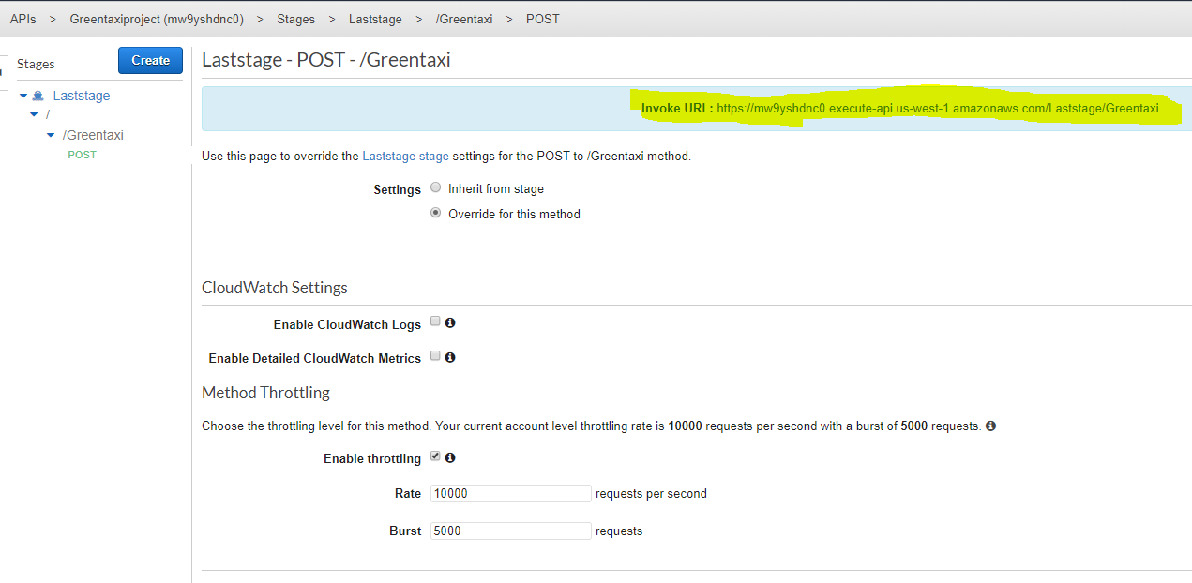
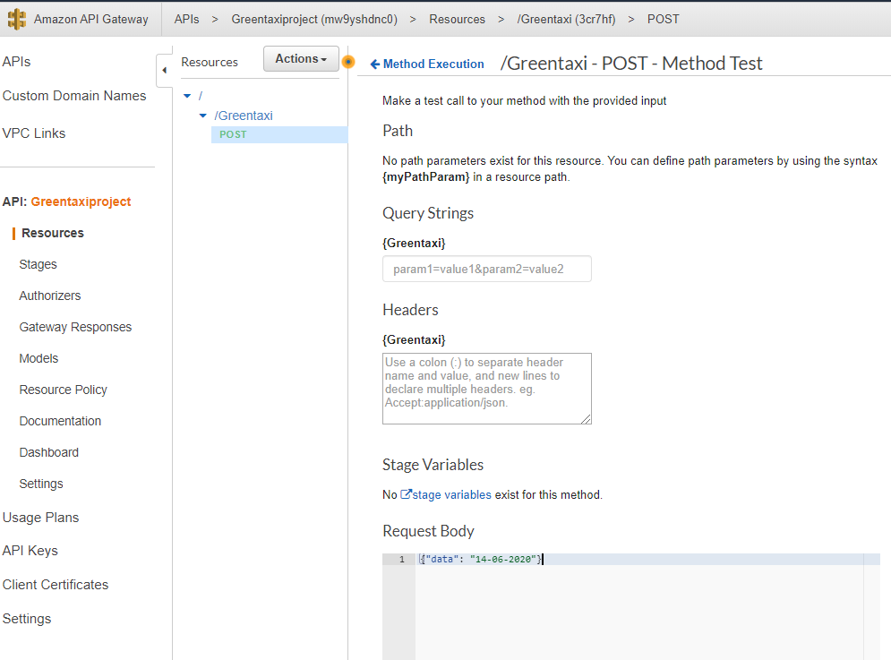

Slide 13
CHALLENGES
Column names and data types were different for different monthly reports so preprocessing the data for analysis was a challenging job
We were unable to integrate Location specific data in our predictions.

Slide 14
FUTURE WORK
We would like to use API collaboration platforms like Postman and provide two user interfaces. We would also integrate location data into our analysis.
User-side Application.
Company Interface.

Slide 15

Thank You!
Any questions?

